Slide 1
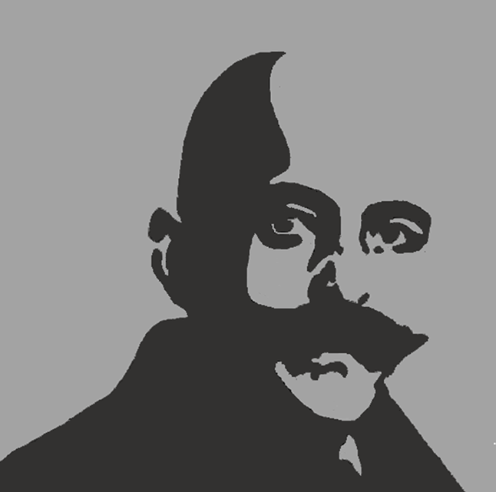
Center for the Study of World Religions
Harvard Divinity School
THE TEACHINGS & LEGACY OF
G.I.GURDJIEFF
Conference Anthology

Slide 3
Center for the Study of World Religions
Harvard Divinity School
THE TEACHINGS & LEGACY OF
G.I.GURDJIEFF
Conference Anthology
Edited by Carole M. Cusack &
GOSIA E. SKLODOWSKA

Slide 4
CENTER FOR THE STUDY OF WORLD RELIGIONS
42 Francis Avenue
Cambridge, MA 02138
cswr.hds.harvard.edu cswr@hds.harvard.edu
Faculty Director
Charles M. Stang
Administration
Gosia Sklodowska, Executive Director
Bhaswar Khan, Assistant Director
Laurie Sedgwick, Events Coordinator
Sarah Iannotti, Administrative Coordinator
Advisory Board, 2024-2025
Mohsen Goudarzi
Tracey Hucks
Teren Sevea
This Publication
Editors: Carole M. Cusack and Gosia E. Sklodowska
Conference Photos: Ashley Zigman
Editing Specialist: Aaron Ullrey
Proofing: Heather Dubnick, Deborah Blackwell
Printing: Red Mill
The Teachings and Legacy of G.I.Gurdjieff: Conference Anthology is an open access publication distributed under the Creative Commons License CC-BY-NC. Under Creative Commons License, authors retain copyright to their articles. A CC-BY-NC license enables reusers to distribute, remix, adapt, and build upon the material in any medium or format for noncommercial purposes only, and only so long as attribution is given to the creator. Other publication copyrights are held by the Center for the Study of World Religions
ISBN 979-8-218-64396-6

Slide 5
Contents
1 Foreword, Charles M. Stang
4 Introduction, Gosia E. Sklodowska
10 G. I. Gurdjieff, the Work, and the Academic Study of Religion, Carole M. Cusack
          15 Gurdjieff, the New Age Movement, and the Guru Field: Making Sense of Multiple Entanglements, Steven Sutcliffe
PART 1
Spiritual and Scientific Influences that Shaped Gurdjieff and His Teachings
      20 Modern Science and Gurdjieff’s Teaching, Charles Langmuir
25 Transformation in Translation: G. I. Gurdjieff as Cosmopolitan of the early Twentieth Century, Michael Pittman
30 Understanding of the East, Ravi Ravindra
PART 2
Embodied Wisdom
35 The Question Remains of the Body, David Appelbaum
38 Gurdjieff: Alchemy, The Emerald Tablet, Contemplation, and Movements, Joseph Azize
43 “She Sees the Is beyond the Seems”: Gurdjieff, Phenomenology, and Embodied Wisdom, David Seamon
49 The Gurdjieff Movements: A Personal Journey, Laurence Morrocco
PART 3
The Values and Value of the Gurdjieff Teaching
53 Mr. Gurdjieff’s Original Approach to Life, Alexandre de Salzmann
57 Transmission, Tradition, and Integrity: Gurdjieffian Scholarship as Third Force, Cynthia Bourgeault
61 The Eighteenth Commandment: What Are the Values of the Gurdjieff Teaching?, Roger Lipsey
PART 4
Cultural Productions
66 The (Hidden) Fourth Way of Jerzy Grotowski, Catharine Dada
70 Icons Are Cosmic Diagrams, Richard Temple
74 Thornton Wilder’s Our Town as a Summation of the Gurdjieff Work, Jon Woodson
79 Piano Recital
80 Authors’ Biographies

Slide 8
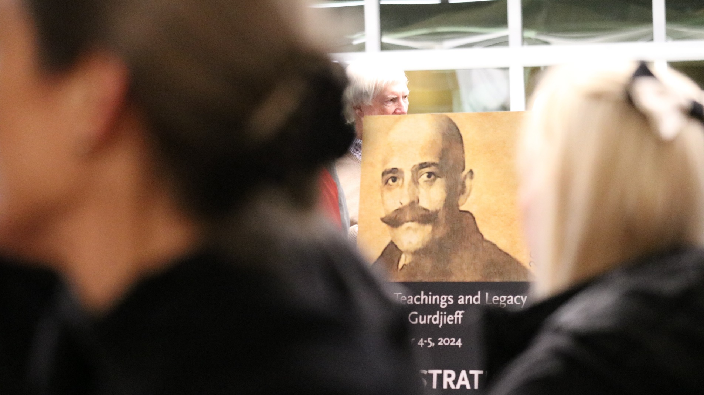
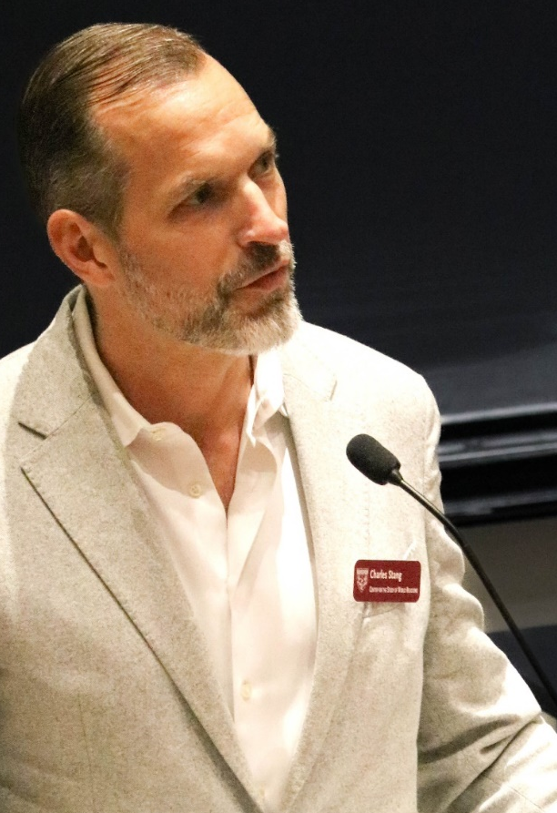
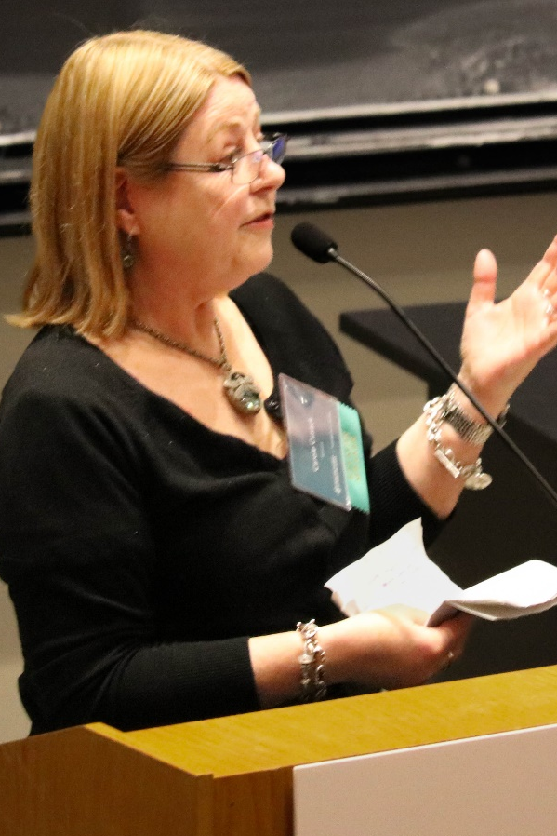
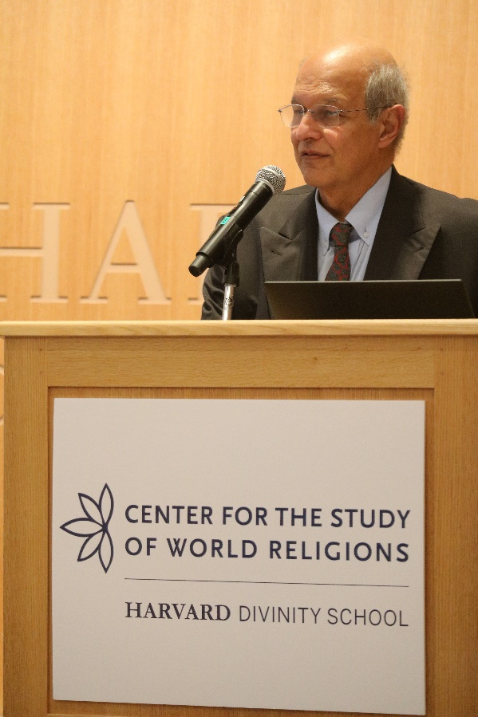
Teachings & Legacy of G.I. Gurdjieff
CONFERENCE, December 4-5, 2024
PHOTO HIGHLIGHTS

Slide 9
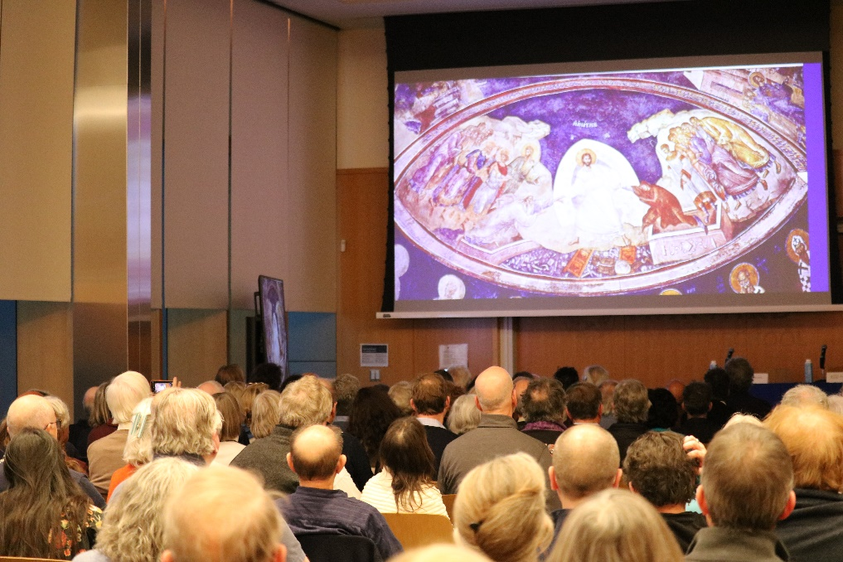
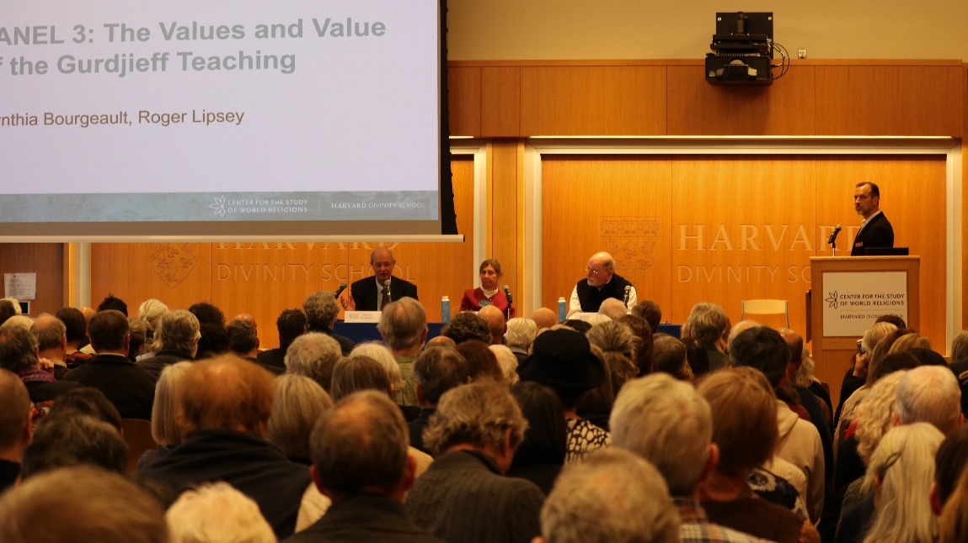
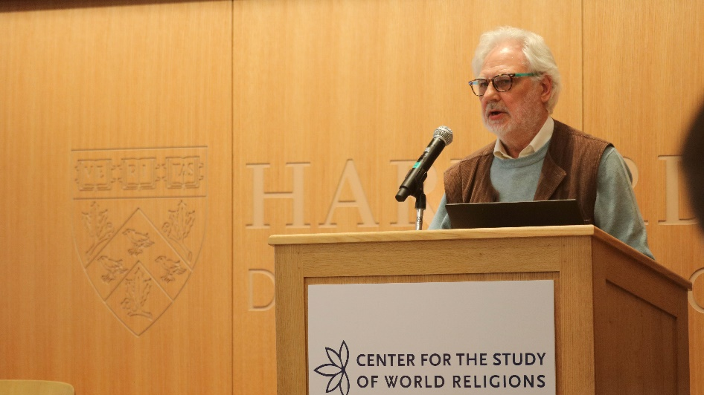
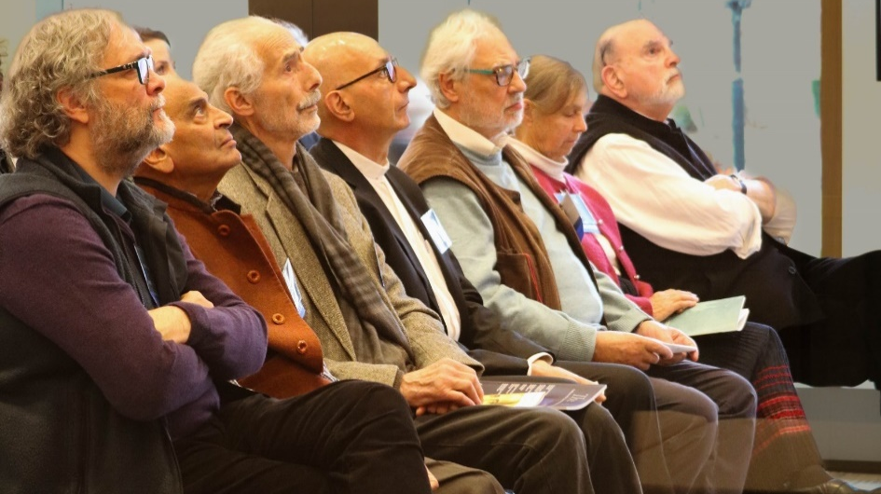
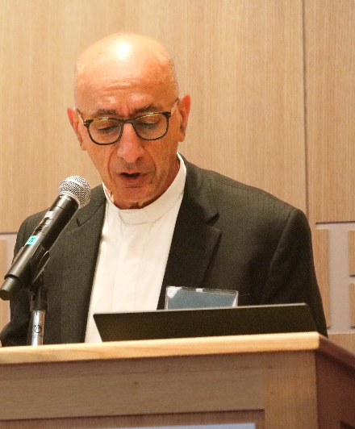
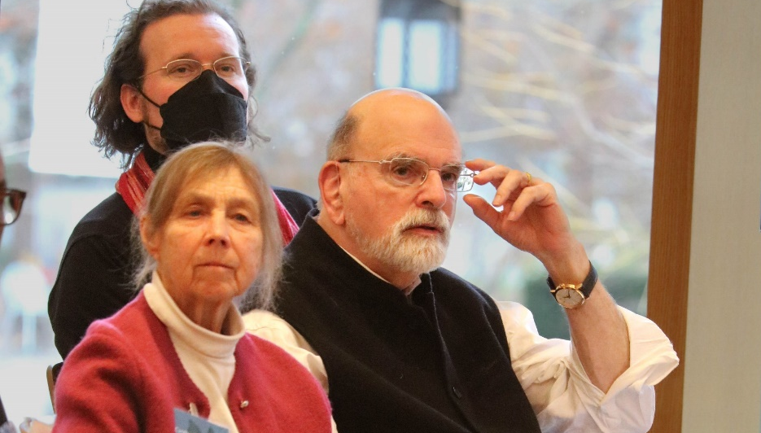
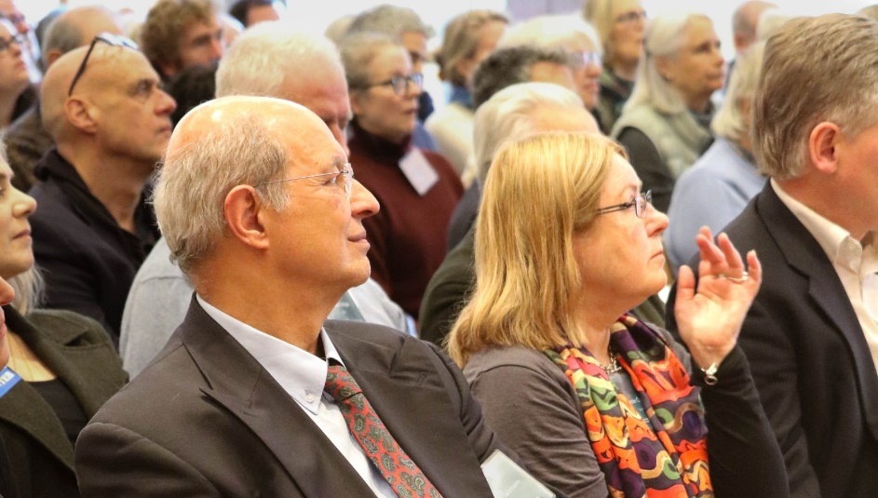
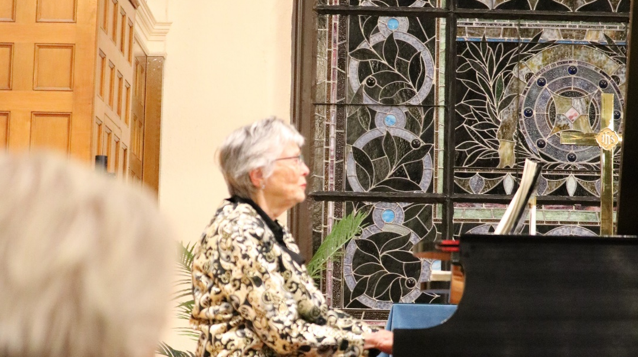
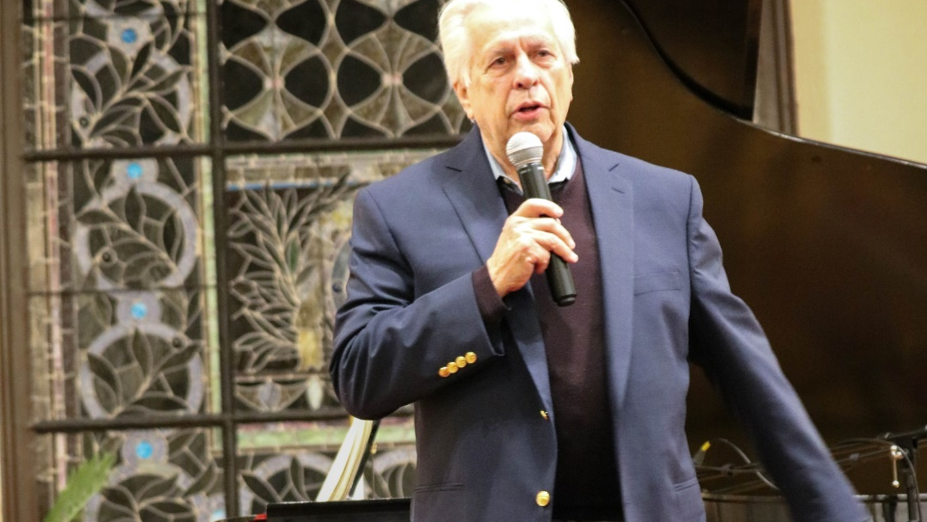

Slide 10
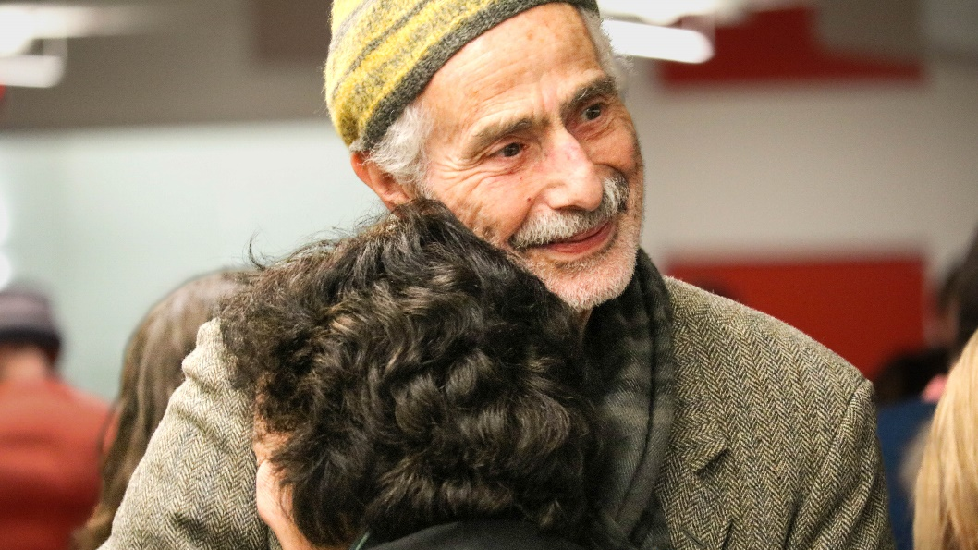
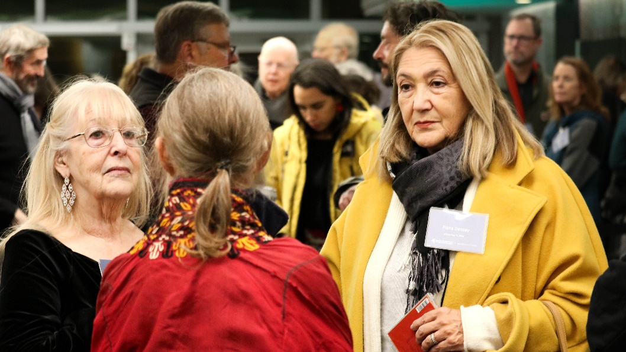
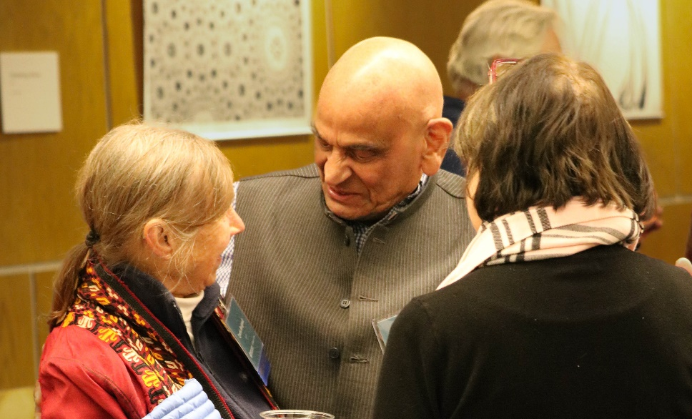
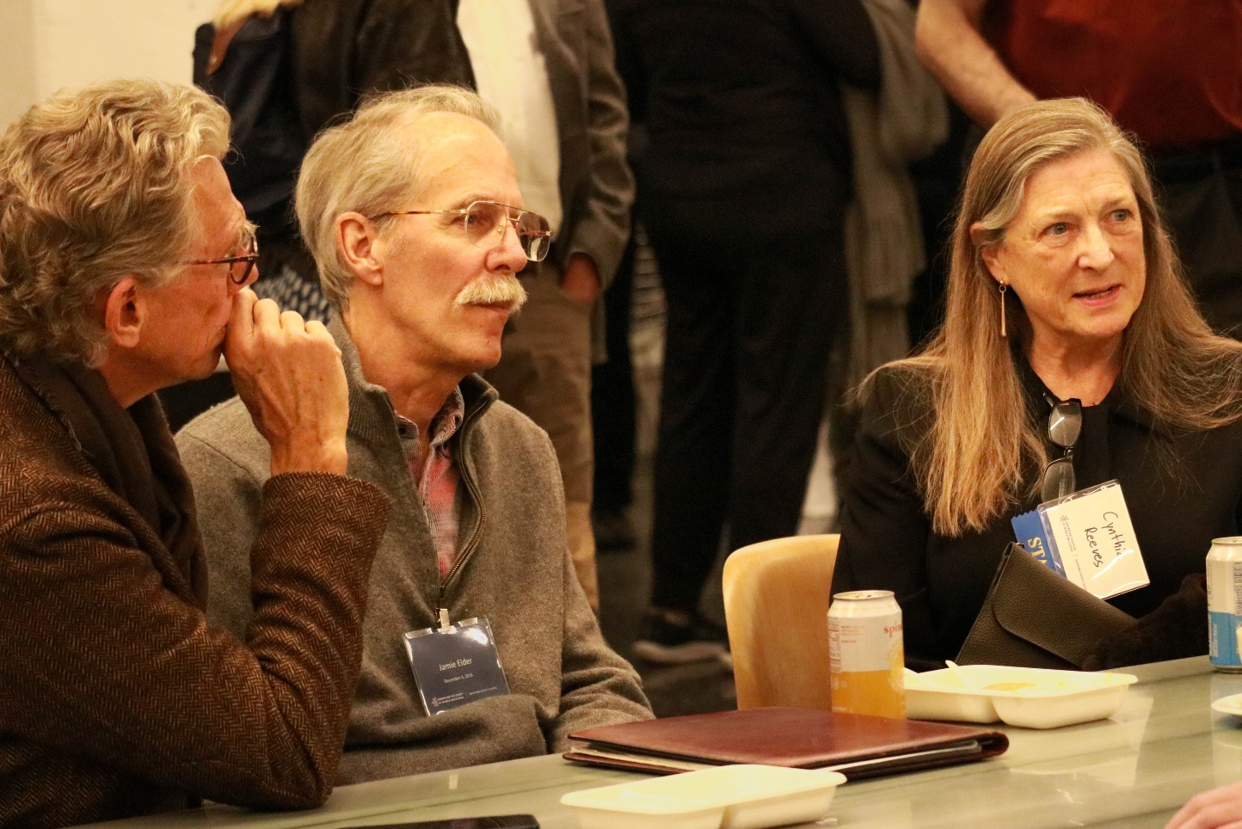
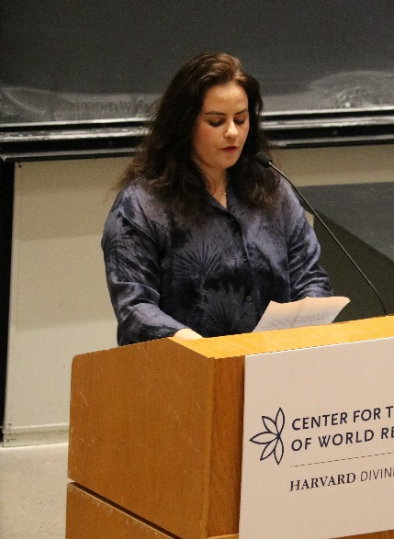
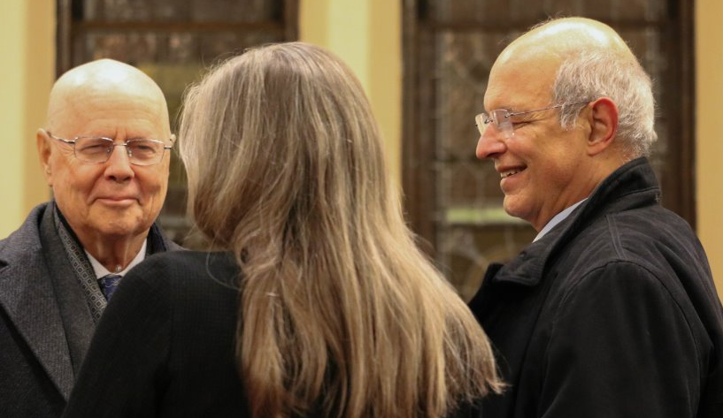
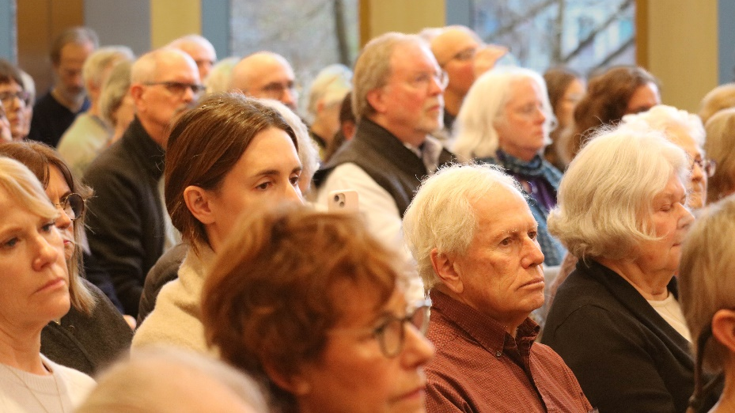
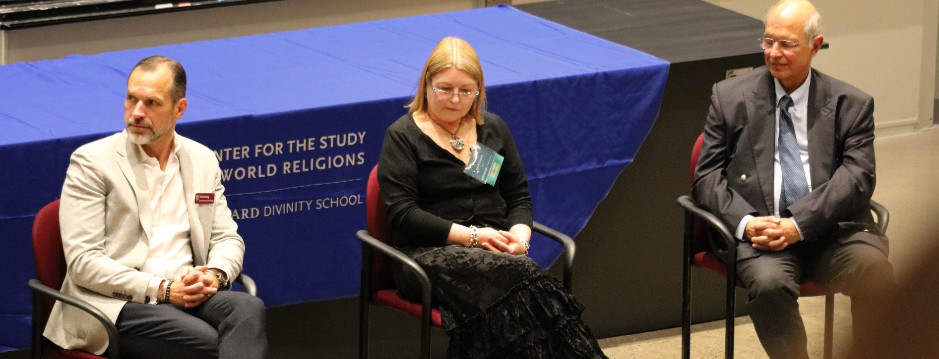

Slide 11

42 Francis Avenue
Cambridge, MA 02138
@
cswr.hds.harvard.edu | cswr@hds.harvard.edu
| eepurl.com/ibpIQb | harvardcswr | harvardcswr | @HarvardCSWR
©2025 Center for the Study of World Religions

